Slide 1
SIFT-Reconstruction
By Luke McMahon and Jason Heflinger

Slide 2
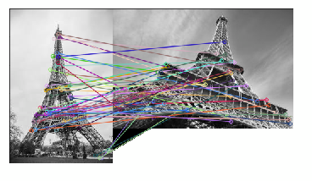
What is SIFT? (Scale Invariant Feature Transform)
Introduced by David Lowe in 1999
A computer vision technique used for detecting and describing local features in images
Widely used now for various applications such as image matching, object recognition, and image stitching
We will be using it attempt 3D model reconstruction from 2 images!

Slide 3
How Does SIFT Work?
Scale-space extrema detection
Keypoint localization
Orientation assignment
Descriptor generalization
Notes:
bruh

Slide 4
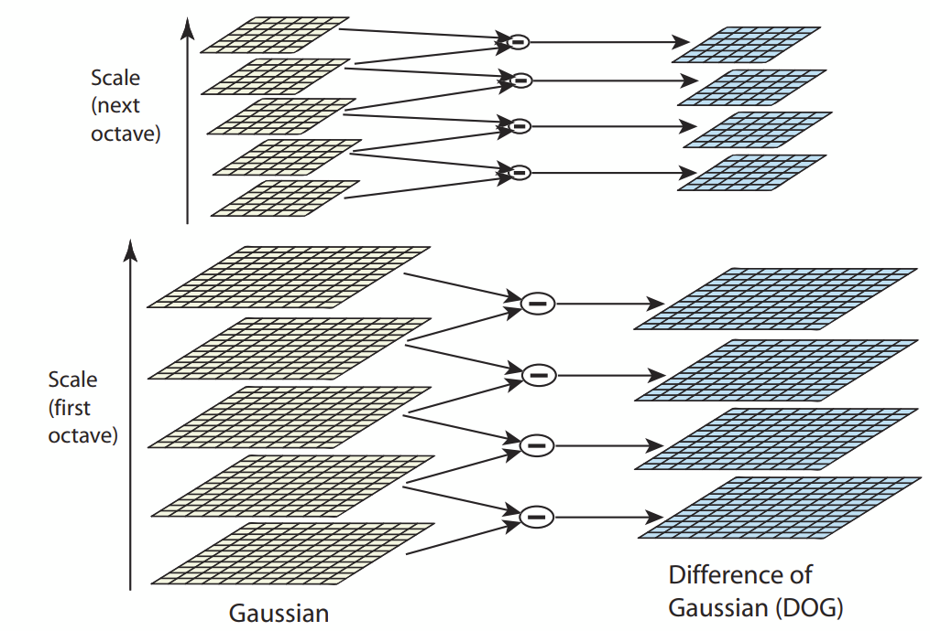
Scale-Space Extrema Detection
SIFT creates a series of progressively blurred versions of the original image, called the scale-space representation
Using DoG (Difference of Gaussians), we can now identify potential keypoints

Slide 5
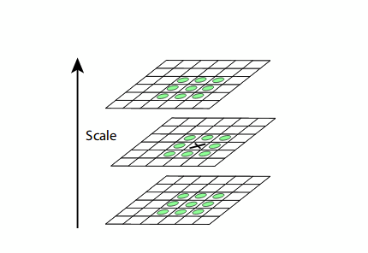
Keypoint Localization
Once potential keypoints are found, we apply a precise localization to eliminate unstable keypoints
This localization is done by fitting a quadratic function to nearby samples to reject keypoints with low contrast

Slide 6
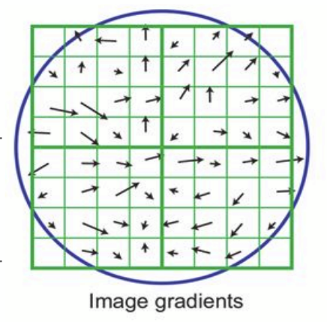
Orientation Assignment
Each keypoint is now assigned an orientation to make the feature invariant to image rotation
This is done using a local orientation histogram in the neighborhood of each keypoint based on gradient orientations

Slide 7
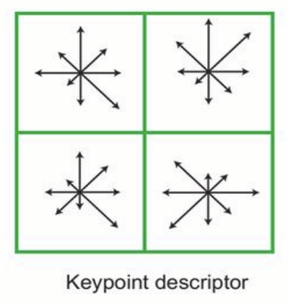
Descriptor Generalization
Each keypoint is given a feature descriptor for the local image region
This is done by capturing the appearance and gradient information from the keypoint neighborhood
This descriptor is robust to scale and rotation, but only partially to illumination and affine transformations

Slide 8
What Next?
Flann-Based Matcher
KNN Match and Lowe’s Ratio Test
RANSAC
Profit

Slide 9
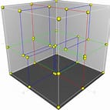
Flann Based Matcher
1000’s of features detected
Not too many work
Flann Based Matcher constructs a k-dimensional space
It then searches for matches using the feature distance

Slide 10
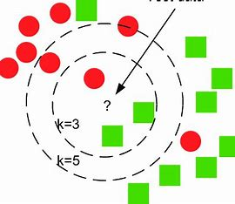
KNN Match and Lowe’s Ratio Test
KNN match doesn’t just find the best match
It instead finds the k best matches (k=2 in this case)
Lowe’s ratio test used to to ensure no close second match
Lowe’s done to ensure features are unique in each image and are not weak correlations

Slide 11
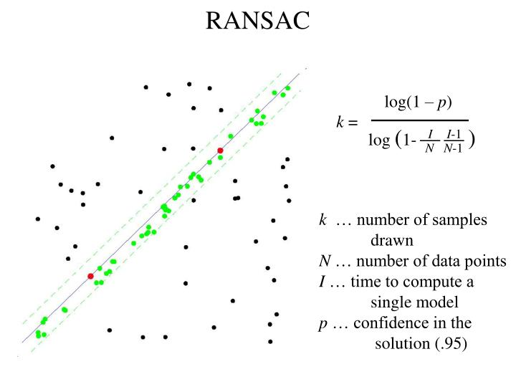
RANSAC
Once reasonable feature matches are left, we use RANSAC
RANSAC ensures only points that correspond to one homography chosen
Through doing this, only good correspondences are chosen

Slide 12
Now we have good correspondences, as seen in this demo:

Slide 13
Reconstruction:
SIFT is wonderful for grabbing correspondences
Fails to prioritize the points we want/need.
Leads to a lack critical information for automatic 3D reconstruction
However, if we had this we could get 3D coordinates, use plane fitting with RANSAC, take each point close to it, map to the plane and convex hull for polygons

Slide 14
Image Stitching
Despite SIFTs inability to handle creating a 3D model, which was our initial purpose, we found that it was very useful at other applications such as Image Stitching. This can be seen in the following demo:

Slide 15
Conclusion
Unfortunately, SIFT is not amazing for automatic 3D model reconstruction.
Even so, it has many computer vision applications that it can fully automate
Because of this, it is a very useful algorithm with regards to computer vision

Slide 16
QUESTIONS?

